Slide 1
Detecting Cyber-Attacks through URL Analysis: A Machine Learning Approach
Name
2024

Slide 2
Introduction
The internet has become a growing part of people’s social lives and has shaped people’s lifestyles, significantly [1].
The vital infrastructures of governments are integrated with the internet, and the internet has become a critical source of socioeconomic growth.
However, the deepening and expansion of internet structures exposes users to new threats, whose diversity is constantly increasing.
Hence, there is a growing need of developing models that can detect these threats in network traffic. One approach of detecting and preventing threats is through Machine Learning.
Machine Learning algorithms are mathematical models that are used for classification, clustering, and regression problems.
Notes:
The deepening and expansion of internet structures exposes users to new threats, whose diversity is constantly increasing, necessitating development of models that can detect these threats in network traffic.

Slide 4
Importing Libraries
import re # regex
from urllib.parse import urlparse
import numpy as np # linear algebra
import pandas as pd # data processing
import matplotlib
import seaborn as sns
import matplotlib.pyplot as plt
sns.set_style('darkgrid')
matplotlib.rcParams['figure.figsize'] = (10, 6)
This section imports several Python libraries that are commonly used in data analysis and visualization tasks.
Urllib.parse
Numpy
Pandas
Matplotlib
Seaborn
Notes:
from urllib.parse import urlparse: This imports a specific function urlparse from the urllib.parse module. It's used for parsing URLs to extract useful components like the domain name.
2. numpy and pandas: These libraries are fundamental in data analysis. numpy provides support for arrays and mathematical operations, while pandas is used for data manipulation and analysis, particularly with structured data like tables.
matplotlib and seaborn: These are libraries used for data visualization. matplotlib is a versatile plotting library, while seaborn is built on top of matplotlib and provides a high-level interface for creating attractive statistical graphics.
Setting Plot Style and Size:
sns.set_style('darkgrid'): This line sets the style of plots generated by seaborn. In this case, it sets the style to a dark grid background, which is often visually appealing for data visualizations.
matplotlib.rcParams['figure.figsize'] = (10, 6): This line sets the default size of plots generated by matplotlib to be 10 inches in width and 6 inches in height. Adjusting plot size can help in creating visualizations that are appropriately sized and easy to interpret.

Slide 5
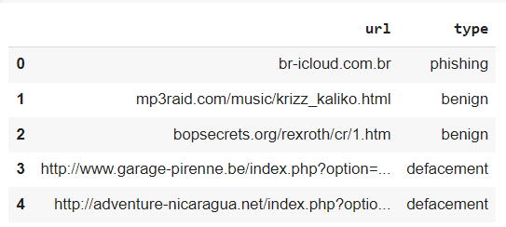
loading a dataset from a CSV
url_df = pd.read_csv("malicious_phish.csv")
url_df.head()
Notes:
This code segment loads a dataset from a CSV file into a Pandas DataFrame and then displays the first few rows of the DataFrame to provide a quick glimpse of the data

Slide 6
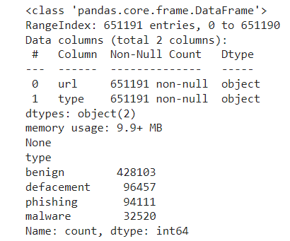
Data Exploration
# Check for missing values and data types
print(url_df.info())
# Check the distribution of classes
print(url_df['type'].value_counts())
Notes:
Checking for Missing Values and Data Types - The info() method provides valuable information about the dataset, including the data types of each column and the presence of missing values
Checking the Distribution of Classes - The value_counts() method helps us understand the distribution of classes within a specific column, which is crucial for tasks like classification.
Importance - Initial data exploration is essential for understanding the structure and contents of the dataset. It helps identify potential issues such as missing values and class imbalances.

Slide 7
Feature selection
#Install library for tokenization of URLs
!pip install url_parser
!pip install chardet
!pip install tldextract
Installing the url_parser Library:
Installing the chardet Library
Installing the tldextract Library:
This is the installation of three Python libraries required for data preprocessing and analysis tasks.
Notes:
Installing the url_parser Library - The url_parser library is being installed using the pip package manager. It provides functionality for parsing and tokenizing URLs, which can be useful for various data processing tasks.
Installing the chardet Library - The chardet library is being installed to assist with character encoding detection, which is important when working with text data of unknown encoding.
Installing the tldextract Library - The tldextract library is being installed for extracting domain-related information from URLs, such as the top-level domain and domain name.

Slide 8
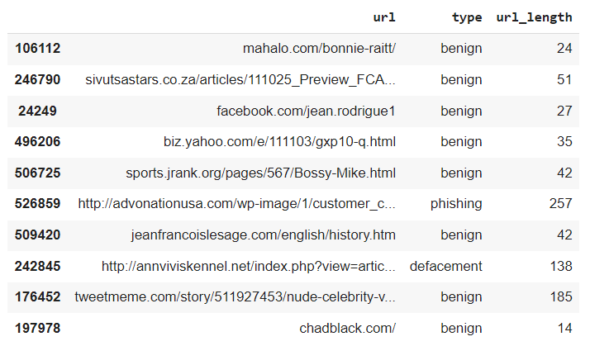
URL Preprocessing
url_df['url_length'] = url_df['url'].apply(len)
url_df.sample(10)
Notes:
Calculating URL Length - The code calculates the length of each URL and adds a new column called 'url_length' to the DataFrame.
Clean and standardized URLs are essential for accurate analysis and modeling in tasks such as url classification

Slide 9
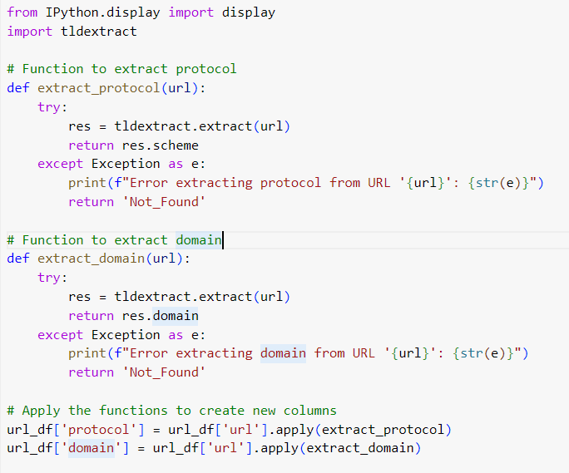
This code segment defines two functions, extract_protocol() and to extract the protocol and extract_domain(), domain from URLs, respectively. It then applies these functions to create new columns 'protocol' and 'domain' in the DataFrame url_df. Finally, it displays the entire DataFrame using the display() function from IPython
Notes:
Defining Functions - Two functions, extract_protocol() and extract_domain(), are defined to extract the protocol and domain from URLs, respectively.
Applying Functions to Create New Columns - The functions are applied to each URL in the DataFrame to create new columns 'protocol' and 'domain’.
NB: Parsing URLs to extract useful components like protocol and domain is essential for various data analysis tasks.
Extracted components can be used for tasks such as categorization, filtering, and feature engineering in data analysis and machine learning.

Slide 10
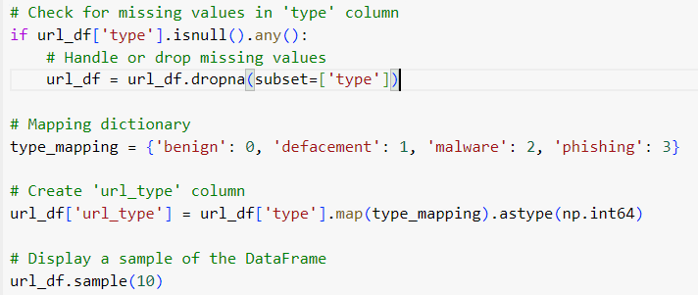
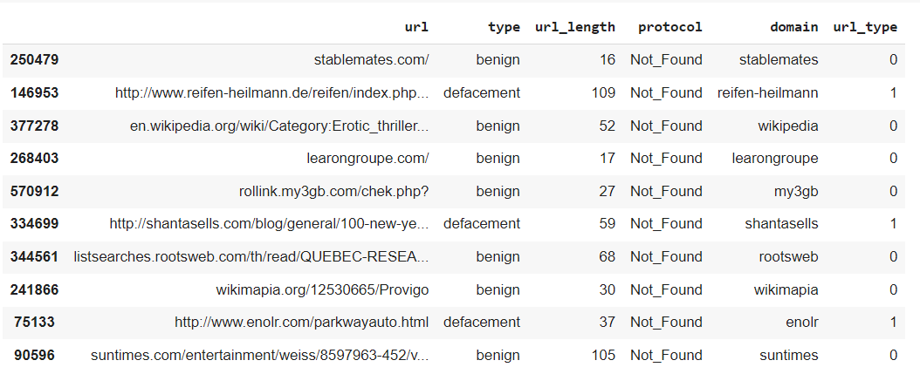
Notes:
Checking for Missing Values - The code checks for missing values in the 'type' column of the DataFrame
Handling Missing Values - Missing values in the 'type' column are dropped from the DataFrame to ensure data integrity.
Mapping Dictionary: - This line creates a new column 'url_type' in the DataFrame url_df. i.e benign is assigned 0, defacement, 1.. {'benign': 0, 'defacement': 1, 'malware': 2, 'phishing': 3}.
Creating 'url_type' Column - A new column 'url_type' is created in the DataFrame, representing numerical codes for the 'type' column.
Displaying the DataFrame - A sample of the DataFrame is displayed to show the newly created 'url_type' column.

Slide 11
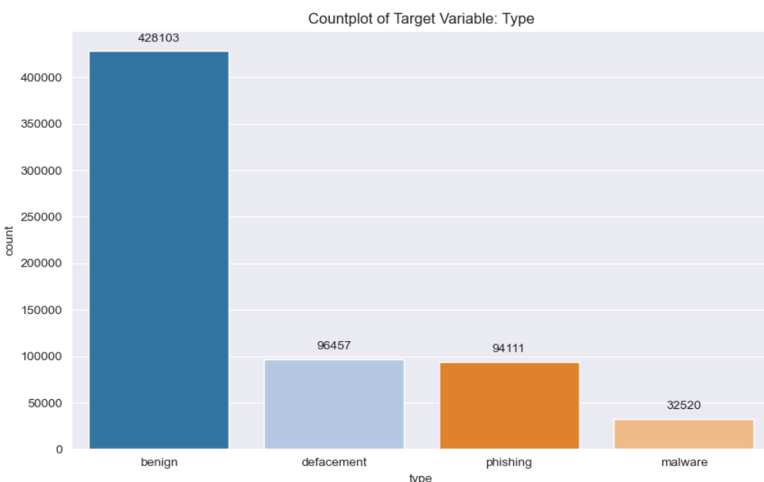
Data visualization
# Countplot
ax = sns.countplot(data=url_df, x='type', palette='tab20', order=url_df['type'].value_counts().index)
# Annotate each bar with its count
for p, label in zip(ax.patches, url_df['type'].value_counts()):
ax.annotate(label, (p.get_x() + p.get_width() / 2., p.get_height()), ha='center', va='center',
xytext=(0, 10), textcoords='offset points')
# Set plot title and show the plot
ax.set_title('Countplot of Target Variable: Type')
plt.show()
Notes:
Creating the Countplot - The code segment creates a countplot to visualize the distribution of the 'type' column in the dataset.
Lable Bars with counts(amount) - Each bar in the countplot is labed with the amount of eg benign, phishing, malware.

Slide 12
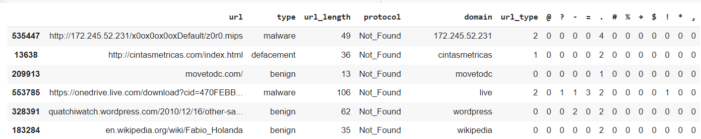
Creating New Features Based on URL Characteristics
feature_chars = ['@', '?', '-', '=', '.', '#', '%', '+', '$', '!', '*', ',']
for char in feature_chars:
url_df[char] = url_df['url'].apply(lambda url: url.count(char))
url_df.sample(10)
Notes:
Defining Feature Characters - A list of special characters is defined to be used as features for identifying their presence in URLs eg @, ?, +
Creating New Features - New columns are created in the dataset to represent the presence of each feature character in URLs
Displaying a Sample of the DataFrame - A sample of the dataset is displayed to show the newly created feature columns alongside the original 'url' column.

Slide 13
Checking if a url is normal or abnormal
def abnormal_url(url: str) -> int:
# Extract hostname from the URL
hostname = urlparse(url).hostname
# Convert hostname to a string
hostname = str(hostname)
# Search for the hostname in the URL
match = re.search(hostname, url)
# Return 1 if a match is found, otherwise return 0
return 1 if match else 0
This function determines whether a given URL is abnormal based on whether its hostname is found within the URL string. If the hostname is present in the URL, the function returns 1; otherwise, it returns 0.
Notes:
Extracting Hostname: - This line extracts the hostname from the URL using the urlparse() function
Converting Hostname to String - This conversion ensures that the hostname is in a format suitable for further processing.
Searching for Hostname in URL: - It looks for an occurrence of the hostname within the URL string.
Returning Result: - This line returns 1 if a match is found (indicating that the hostname is present in the URL) and 0 otherwise

Slide 14
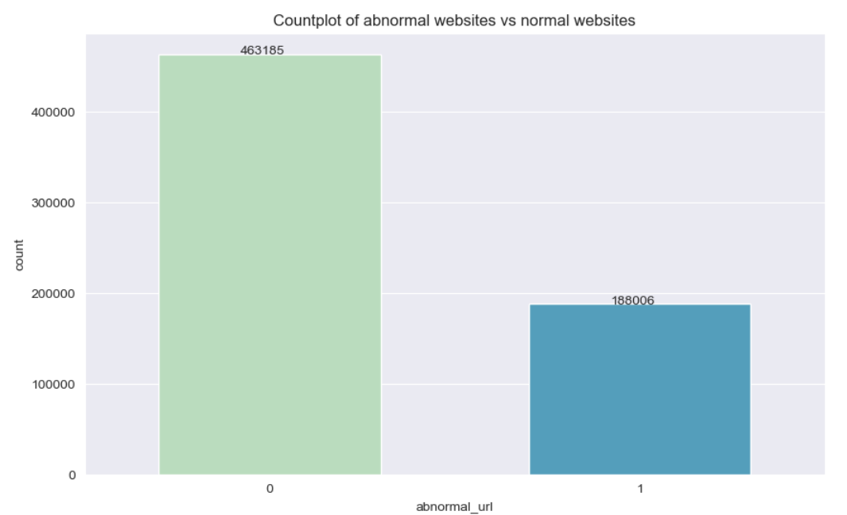
visualize the distribution of abnormal and normal websites
# Countplot
ax = sns.countplot(
data=url_df, x='abnormal_url', palette='GnBu', width=.6, order=url_df['abnormal_url'].value_counts().index
)
# Annotate each bar with its count
for p, label in zip(ax.patches, url_df['abnormal_url'].value_counts()):
ax.annotate(label, (p.get_x() + .22, p.get_height() + 1))
# Set plot title
ax.set_title('Countplot of abnormal websites vs normal websites')
# Show the plot
plt.show()
Notes:
Creating the Countplot - The code segment creates a countplot to visualize the distribution of abnormal and normal websites based on the 'abnormal_url' column
Lable Bars with Counts(Amount) – Each bar is labelled with the amount of normal or abnormal counts

Slide 15
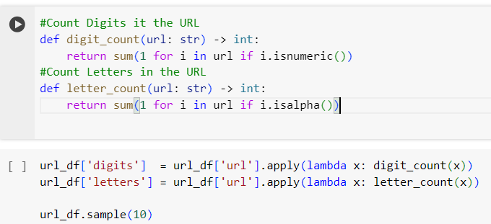
Counting Digits and Letters in URL
This code segment defines two functions, digit_count and letter_count, to count the number of digits and letters, respectively, in a given URL. It then applies these functions to create two new columns, 'digits' and 'letters', in the DataFrame url_df
Notes:
Defining Functions - Two functions, digit_count and letter_count, are defined to count the number of digits and letters in URLs, respectively.
Applying Functions to Create New Columns - The functions are applied to each URL in the dataset to create new columns 'digits' and 'letters' representing the counts of digits and letters

Slide 16
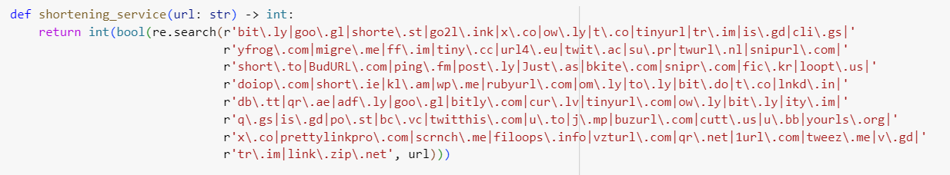
Checking whether URL uses url shortening services
This function, shortening_service, takes a URL as input and returns an integer indicating whether the URL is from a URL shortening service
Notes:
Regular Expression Pattern - The function uses a regular expression pattern to match common URL shortening service domains
Function Definition - The shortening_service function is defined to determine whether a given URL belongs to a URL shortening service
Applying Function to Create New Column - The function is applied to each URL in the dataset to create a new column indicating whether the URL belongs to a shortening service.

Slide 17
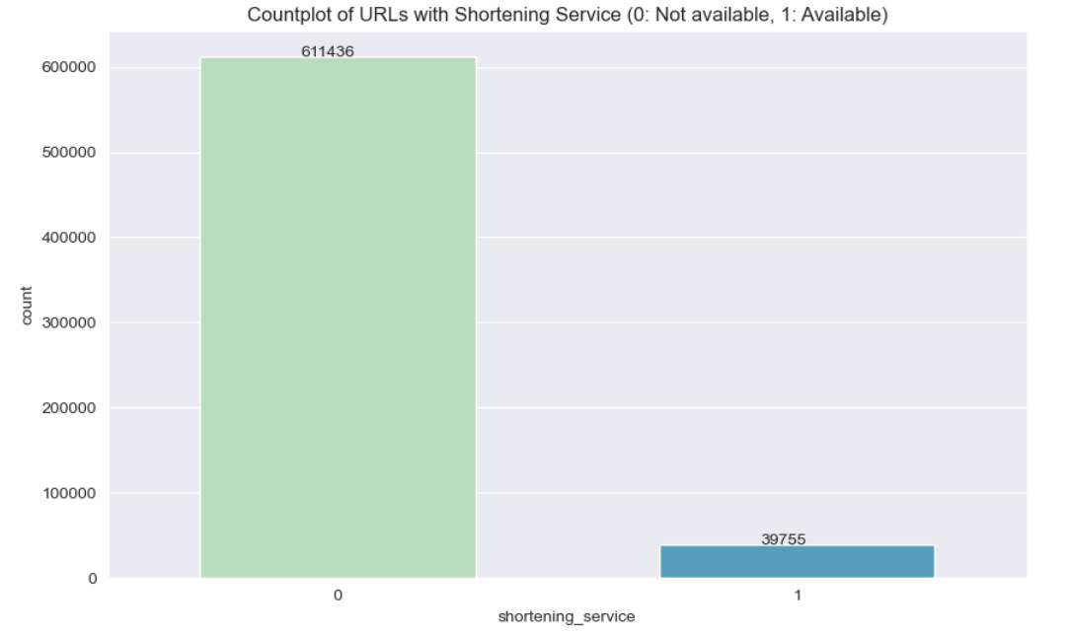
Countplot for urls with shortening services
# Countplot for shortening service
ax = sns.countplot(
data=url_df,
x='shortening_service',
palette='GnBu',
order=url_df['shortening_service'].value_counts().index,
width=.6
)
# Annotate each bar with its count
for p, label in zip(ax.patches, url_df['shortening_service'].value_counts()):
ax.annotate(label, (p.get_x() + .22, p.get_height() + 1))
# Set plot title and show the plot
ax.set_title('Countplot of URLs with Shortening Service (0: Not available, 1: Available)')
plt.show()
Notes:
Creating the Countplot - The code segment creates a countplot to visualize the distribution of URLs with and without URL shortening services
Visualizing the distribution of URLs with and without URL shortening services helps understand the existence of shortening services in the dataset.

Slide 18
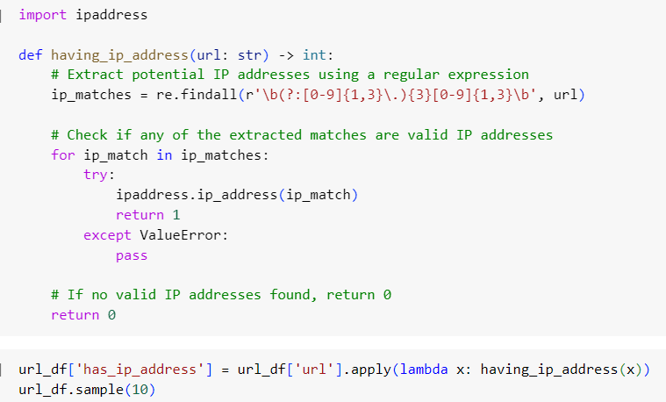
Check whether URL contains IP Address
This code segment defines a function named having_ip_address to determine whether a URL contains an IP address
Notes:
Regular Expression Pattern - The function uses a regular expression pattern to find potential IP addresses within URLs.
The having_ip_address function is defined to determine whether a given URL contains an IP address.
Applying Function to Create New Column - The function is applied to each URL in the dataset to create a new column indicating whether the URL contains an IP address.

Slide 19
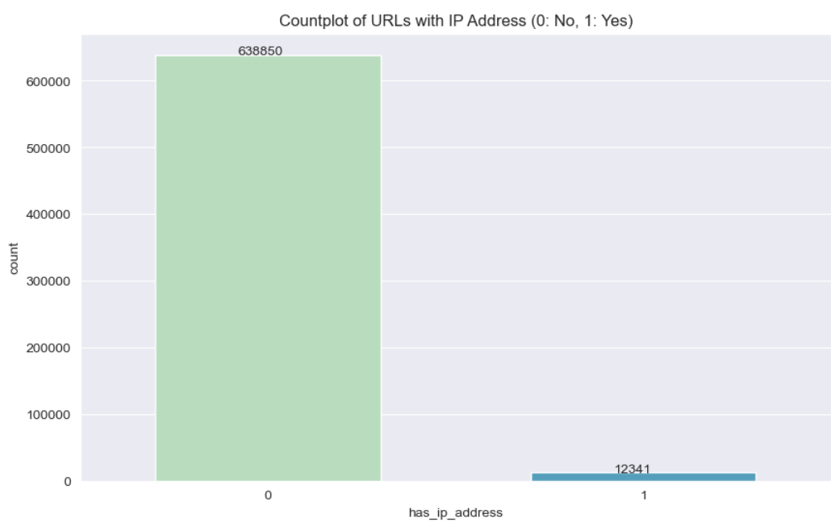
Visualization for urls with ip addresses
# Countplot for
ax = sns.countplot(
data=url_df,
x=url_df['has_ip_address'], # Apply the function to each URL in the DataFrame
palette='GnBu',
order=url_df['has_ip_address'].value_counts().index,
width=.6
)
# Annotate each bar with its count
for p, label in zip(ax.patches, url_df['has_ip_address'].value_counts()):
ax.annotate(label, (p.get_x() + .22, p.get_height() + 1))
# Set plot title and show the plot
ax.set_title('Countplot of URLs with IP Address (0: No, 1: Yes)')
plt.show()

Slide 20
Research aim and objectives
Research Purpose
The study aimed to detect cyber-attacks through URL analysis using a machine learning approach.
Research Objective
To analyze historical URL cyber-attack data
To define and classify specific threats
To identify relevant features and characteristics of URL ransomware behavior
To develop a tailored machine learning model
To design and implement a machine learning model tailored to the unique characteristics of the URL, with a focus on detecting specific cyber-attacks
Notes:
The aim of the study is to extract features from URL that could enable the researcher to classify a given url as either benign, or not benign.

Slide 21
Research methodology
Data
The data was in form of a csv file for urls classified as benign, malware, phishing and defacement.
The data was sourced from the Kaggle website.
Kaggle is the world’s largest data science platform where machine learners share, stress, test, and stay up-to-date on all the latest ML techniques and technologies.
The aim of the study was to extract features from URL that could enable the researcher to classify a given url as either benign, or not benign.

Slide 22
Research methodology continues
Feature Selection and Prediction Model
The study used mutual information gain to find the most important features from the dataset.
The feature selection procedure aimed at identification of top 10 best features
The study fitted the data to two models XGBoost and random forest.
The best model was chosen based on models’ accuracy.
Notes:
Information gain compares the entropy of the dataset before and after a transformation. Mutual information calculates dependence between two variables and is the name given to information gain when applied to variable selection.

Slide 23
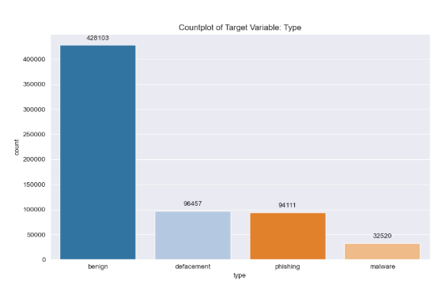
Results and Discussions
Feature Identification
The features identified included type, URL length, protocol, domain url_type, characters (@, ?, -, =, …, +, $, \, !, *, and ,) abnormal URL, digits, letters, shortening services, and IP address.
Benign type had the majority URLs with a frequency of 428103.
A majority of the URLs, with a frequency of 463185, led to abnormal websites, while the minority, with a frequency of 188006, led to normal websites.
For the shortening services, the frequencies were 611436 and 39755 for those without and with shortening services, respectively.
Notes:
The study showed that the URLs varied greatly across the identified features.

Slide 24
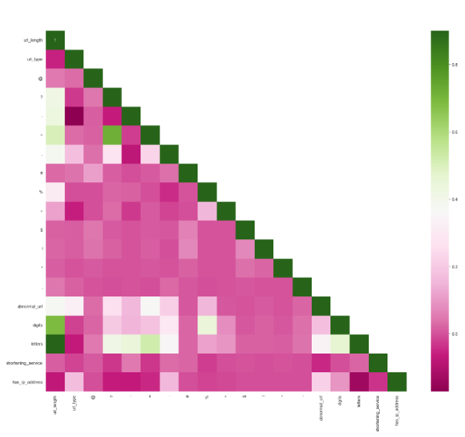
Results and Discussions
Correlation Heat Map
The correlation heatmap was critical for identifying features that could potentially result in multicollinearity.
Multicollinearity would compromise the integrity of the models. From the analysis, only three pairs had high correlation.
The rest of the pairs indicated very weak correlation, implying that the features identified had no significant potential for multicollinearity.
Notes:
The correlation assessed how the pairs of features correlated. Green color indicated strong correlation while pink color indicated no or weak correlation.

Slide 25
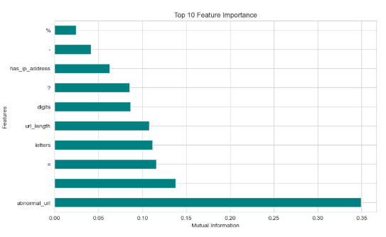
Results and Discussions
Feature Selection
The study analyzed feature importance using mutual information.
The study computed the information gain with mutual information and used the results to sort the features in descending order.
From the analysis, the top 10 features in terms of importance included %, -, has IP address, ?, digits, URL length, letters, =, ., and abnormal URL, with estimated mutual information scores of 0.025, 0.004, 0.006, 0.008, 0.008, 0.11, 0.12, 0.125, 0.14, and 0.35, respectively.
Notes:
The values indicated the relative importance of each feature in making predictions. Hence, the most important features were those with the highest mutual information scores.

Slide 26
Results and Discussions
Prediction Model 1: XGBoost
Prediction Model 1: Random Forest
Accuracy | 0.8975
Precision | 0.8913
Recall | 0.8975
F1 Score | 0.8911
ROC-AUC score | 0.9711
Accuracy | 0.9189
Precision | 0.9156
Recall | 0.9189
F1 Score | 0.9163
ROC-AUC score | 0.9759
Notes:
For the XGBoost model; the model correctly predicted 89.75% of the cases. The study used the AUC-ROC to measure the model’s ability to distinguish between positive and negative cases. Values close to 0.5 represents random guess, while those close to 1.0 represents good discrimination. The analysis of the fitted XGBoost model produced an AUC-ROC score of 0.9711, suggesting a good discriminatory power. Also, the study used precision to indicate the proportion of true positive predictions among all positive predictions. The value was important as it measured the number of positive instances were predicted as positive [2]. The analysis of the XGBoost model produced a precision of 0.8913 indicating that about 89.13% of the predicted positives were actually positive. Further, the analysis produced a recall (sensitivity) score of 0.8975. The recall value indicated that the proportion of true positive predictions among all actual positives was 89.75%. The harmonic mean of precision and recall was measured using the F1 score. The analysis produced an F1 score of 89.11%. The value was high indicating a high performance of the XGBoost model.
Conversely, for the Random Forest Model, the study produced an accuracy score of 0.9189, implying that the Random Forest model correctly predicted 91.89% of the cases. The study used the AUC-ROC to measure the model’s ability to distinguish between positive and negative cases. Values close to 0.5 represents random guess, while those close to 1.0 represents good discrimination. The analysis of the fitted Random Forest model produced an AUC-ROC score of 0.9758, suggesting a good discriminatory power. Also, the study used precision to indicate the proportion of true positive predictions among all positive predictions. The value was important as it measured the number of positive instances were predicted as positive. The analysis of the Random Forest model produced a precision of 0.9156 indicating that about 91.56% of the predicted positives were actually positive. Further, the analysis produced a recall (sensitivity) score of 0.9189. The recall value indicated that the proportion of true positive predictions among all actual positives was 91.89%. The harmonic mean of precision and recall was measured using the F1 score. The analysis produced an F1 score of 91.63%. The value was high indicating a high performance of the Random Forest model.

Slide 27
Results and Discussions
Comparing the two models
The two models were compared using the evaluation metrics.
The analysis showed that Random Forest model produced better scores for all the evaluation metrics.
Therefore, the study concluded that Random Forest model was the most optimal model for predicting a given url as either benign, or not benign.
Notes:
The comparison analysis showed that Random Forest Model was a better prediction model than XGBoost model.

Slide 28
Conclusions
The study concluded that Random Forest model produced better scores for all the evaluation metrics.
Therefore, the study concluded that Random Forest model was the most optimal model for predicting a given url as either benign, or not benign.
According to the analysis, the prediction would achieve accuracy, precision, recall F1, and ROC-AUC scores equal to 0.9189, 0.9156, 0.9189, 0.9163, and 0.9759, respectively.

Slide 29
References
Bouyeddou, Benamar, Fouzi Harrou, Benamar Kadri, and Ying Sun. "Detecting network cyber-attacks using an integrated statistical approach." Cluster Computing 24 (2021): 1435-1453.
Kotenko, Igor, Igor Saenko, Oleg Lauta, and Aleksander Kribel. "An approach to detecting cyber attacks against smart power grids based on the analysis of network traffic self-similarity." Energies 13, no. 19 (2020): 5031.

Slide 30


